Slide 1
PROJECT TITLE
TSP- AI ML Fundamentals (Capstone Project)
Presented By:
Student Name : P.sudharsanam
NM ID College Name:au2021109306, college of engineering guindy
Guided By:Ramar

Slide 2
OUTLINE
Problem Statement (Should not include solution)
Proposed System/Solution
Algorithm & Deployment
GitHub Link
Project Demo(photos / videos)
Conclusion
Future Scope
References

Slide 3
Problem Statement
To create a chatbot using chatgpt as project using python language

Slide 4
Proposed Solution
A chat bot was created using python.

Slide 5
Algorithm & Deployment
AI chatbots utilize algorithms like rule-based systems, machine learning (supervised/unsupervised), NLP, reinforcement learning, and deep learning. These algorithms enable chatbots to understand human language, generate responses, and improve over time. Combining these techniques enhances conversational experiences, ensuring effective communication between users and chatbots.

Slide 6
GitHub Link
Psudhar/Naan-mudhalvan-
https://github.com/Psudhar/Naan-mudhalvan-

Slide 7
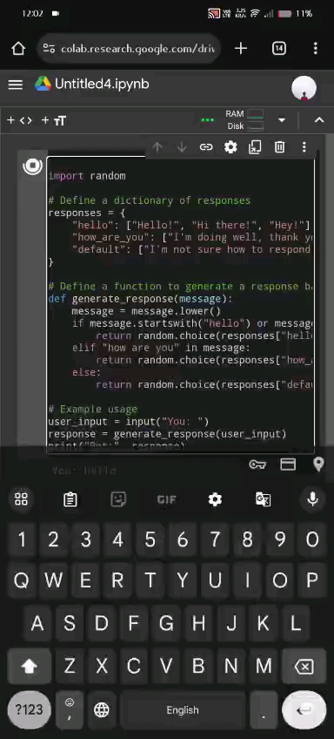
Project Demo(Recorded Video)

Slide 8
Conclusion
In conclusion, AI chatbots offer efficient, personalized interactions, enhancing user experiences while streamlining processes. As they continue to evolve, their potential to revolutionize customer service and communication remains boundless.

Slide 9
Future Scope
The future scope of AI chatbots includes advanced natural language understanding, personalized conversational experiences, integration with virtual and augmented reality, and enhanced emotional intelligence for empathetic interactions.

Slide 10
References
https://www.ibm.com/watson/assistant/
https://cloud.google.com/dialogflow
https://azure.microsoft.com/en-us/services/bot-service/

Slide 11
THANK YOU

